Slide 1
Cyber Security Awareness
Why it’s important and what can you do?
Michelle Zezulak
Director of Risk Management
Catholic Mutual Group

Slide 2

Why is Cyber Security Awareness Important?
Cyber touches everything!
Critical Infrastructure
  Power, water, gas, healthcare, banking, transportation, etc.
Military and industry
Personal lives
  School, work, and home

Slide 3
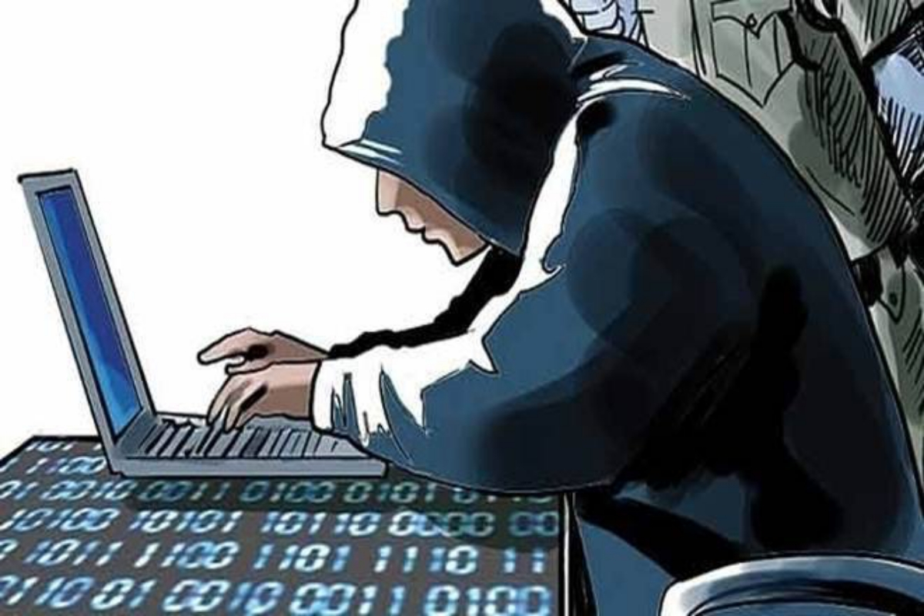
Why is Cyber Crime so Attractive?

Slide 4
Cyber criminals are virtually invisible – and difficult to catch
Cyber criminals make more money with less risk
Tools are readily available for purchase and download
Unsecured systems are easy targets:
  Why go through the hassle of smashing through the door when you can ask someone to hand it to you?

Slide 5
Did you know?
Hackers attack every 39 seconds
94% of malware is delivered by email
1 in 13 web requests lead to malware
Smaller organizations (1-250 employees) have the highest targeted malicious email rate
The most expensive cost of a cyber attack is information loss
95% of cyber security breaches are caused by human error

Slide 6
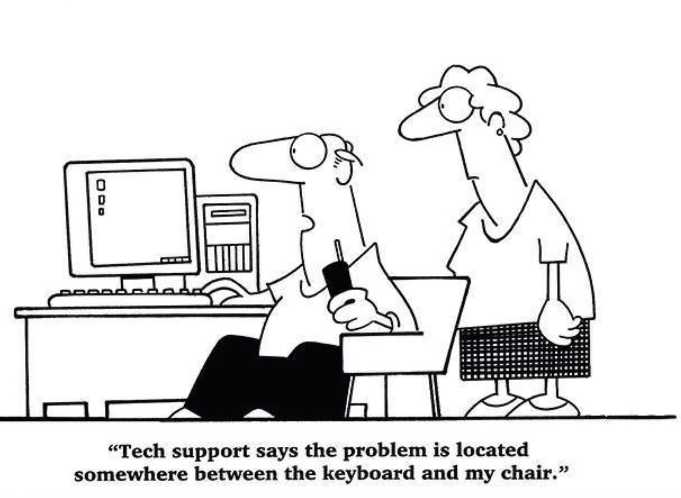

Slide 7
What Types of Claims are We Seeing?
Ransomware
Cyber Extortion
Security/Privacy Breach
Vulnerability Events
Wire Transfer/Financial Fraud

Slide 8
There is More to the Claim than Just the Claim Cost
Data Recovery
Legal
Notification

Slide 9
What can we do to prevent cyber attacks on your systems?
Catholic Mutual Group Risk Management is focusing on 3 key components:
Planning and Implementing a Policy
MFA and other Cyber Security Tools
End User training

Slide 10
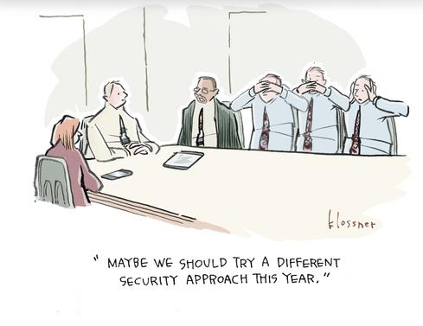

Slide 11
Cyber Security Policy – Where You Can Start
What you currently do for Cyber Security
What you have for equipment, access and security tools
What the contingency plan considers
What the training program looks like
Knowing what to do if a breach, even a suspected one happens

Slide 12
What is your current state of Cyber Security?
Identify who handles your Cyber Security
Document what programs, anti-virus and anti-malware is installed
Document how often is our operating system updated and scanned for viruses
Determine whether all your locations are following the same plan
Assess how often passwords are changed
Document whether old accounts and system access for people no longer employed are shut down

Slide 13
What Equipment Do You Have and Who Has it?
An equipment inventory list is easy to create and can be started with a few simple items:
Desktop/Device Number or type
Person to whom it is assigned
Is the device personal or provided by the Arch/Diocese?
Primary email address/provider (if not Arch/Diocesan)
What systems does this person have access to?
Is the device current with all security (Antivirus, firewalls, etc.)

Slide 14
Contingency Planning
Identify what the essential functions needed for business should a major system failure occur
Identify and document where, when and how records are backed up
Test the recovery process
All staff should be able to identify when a cyber security incident occurs
The contingency plan should be documented and distributed

Slide 15
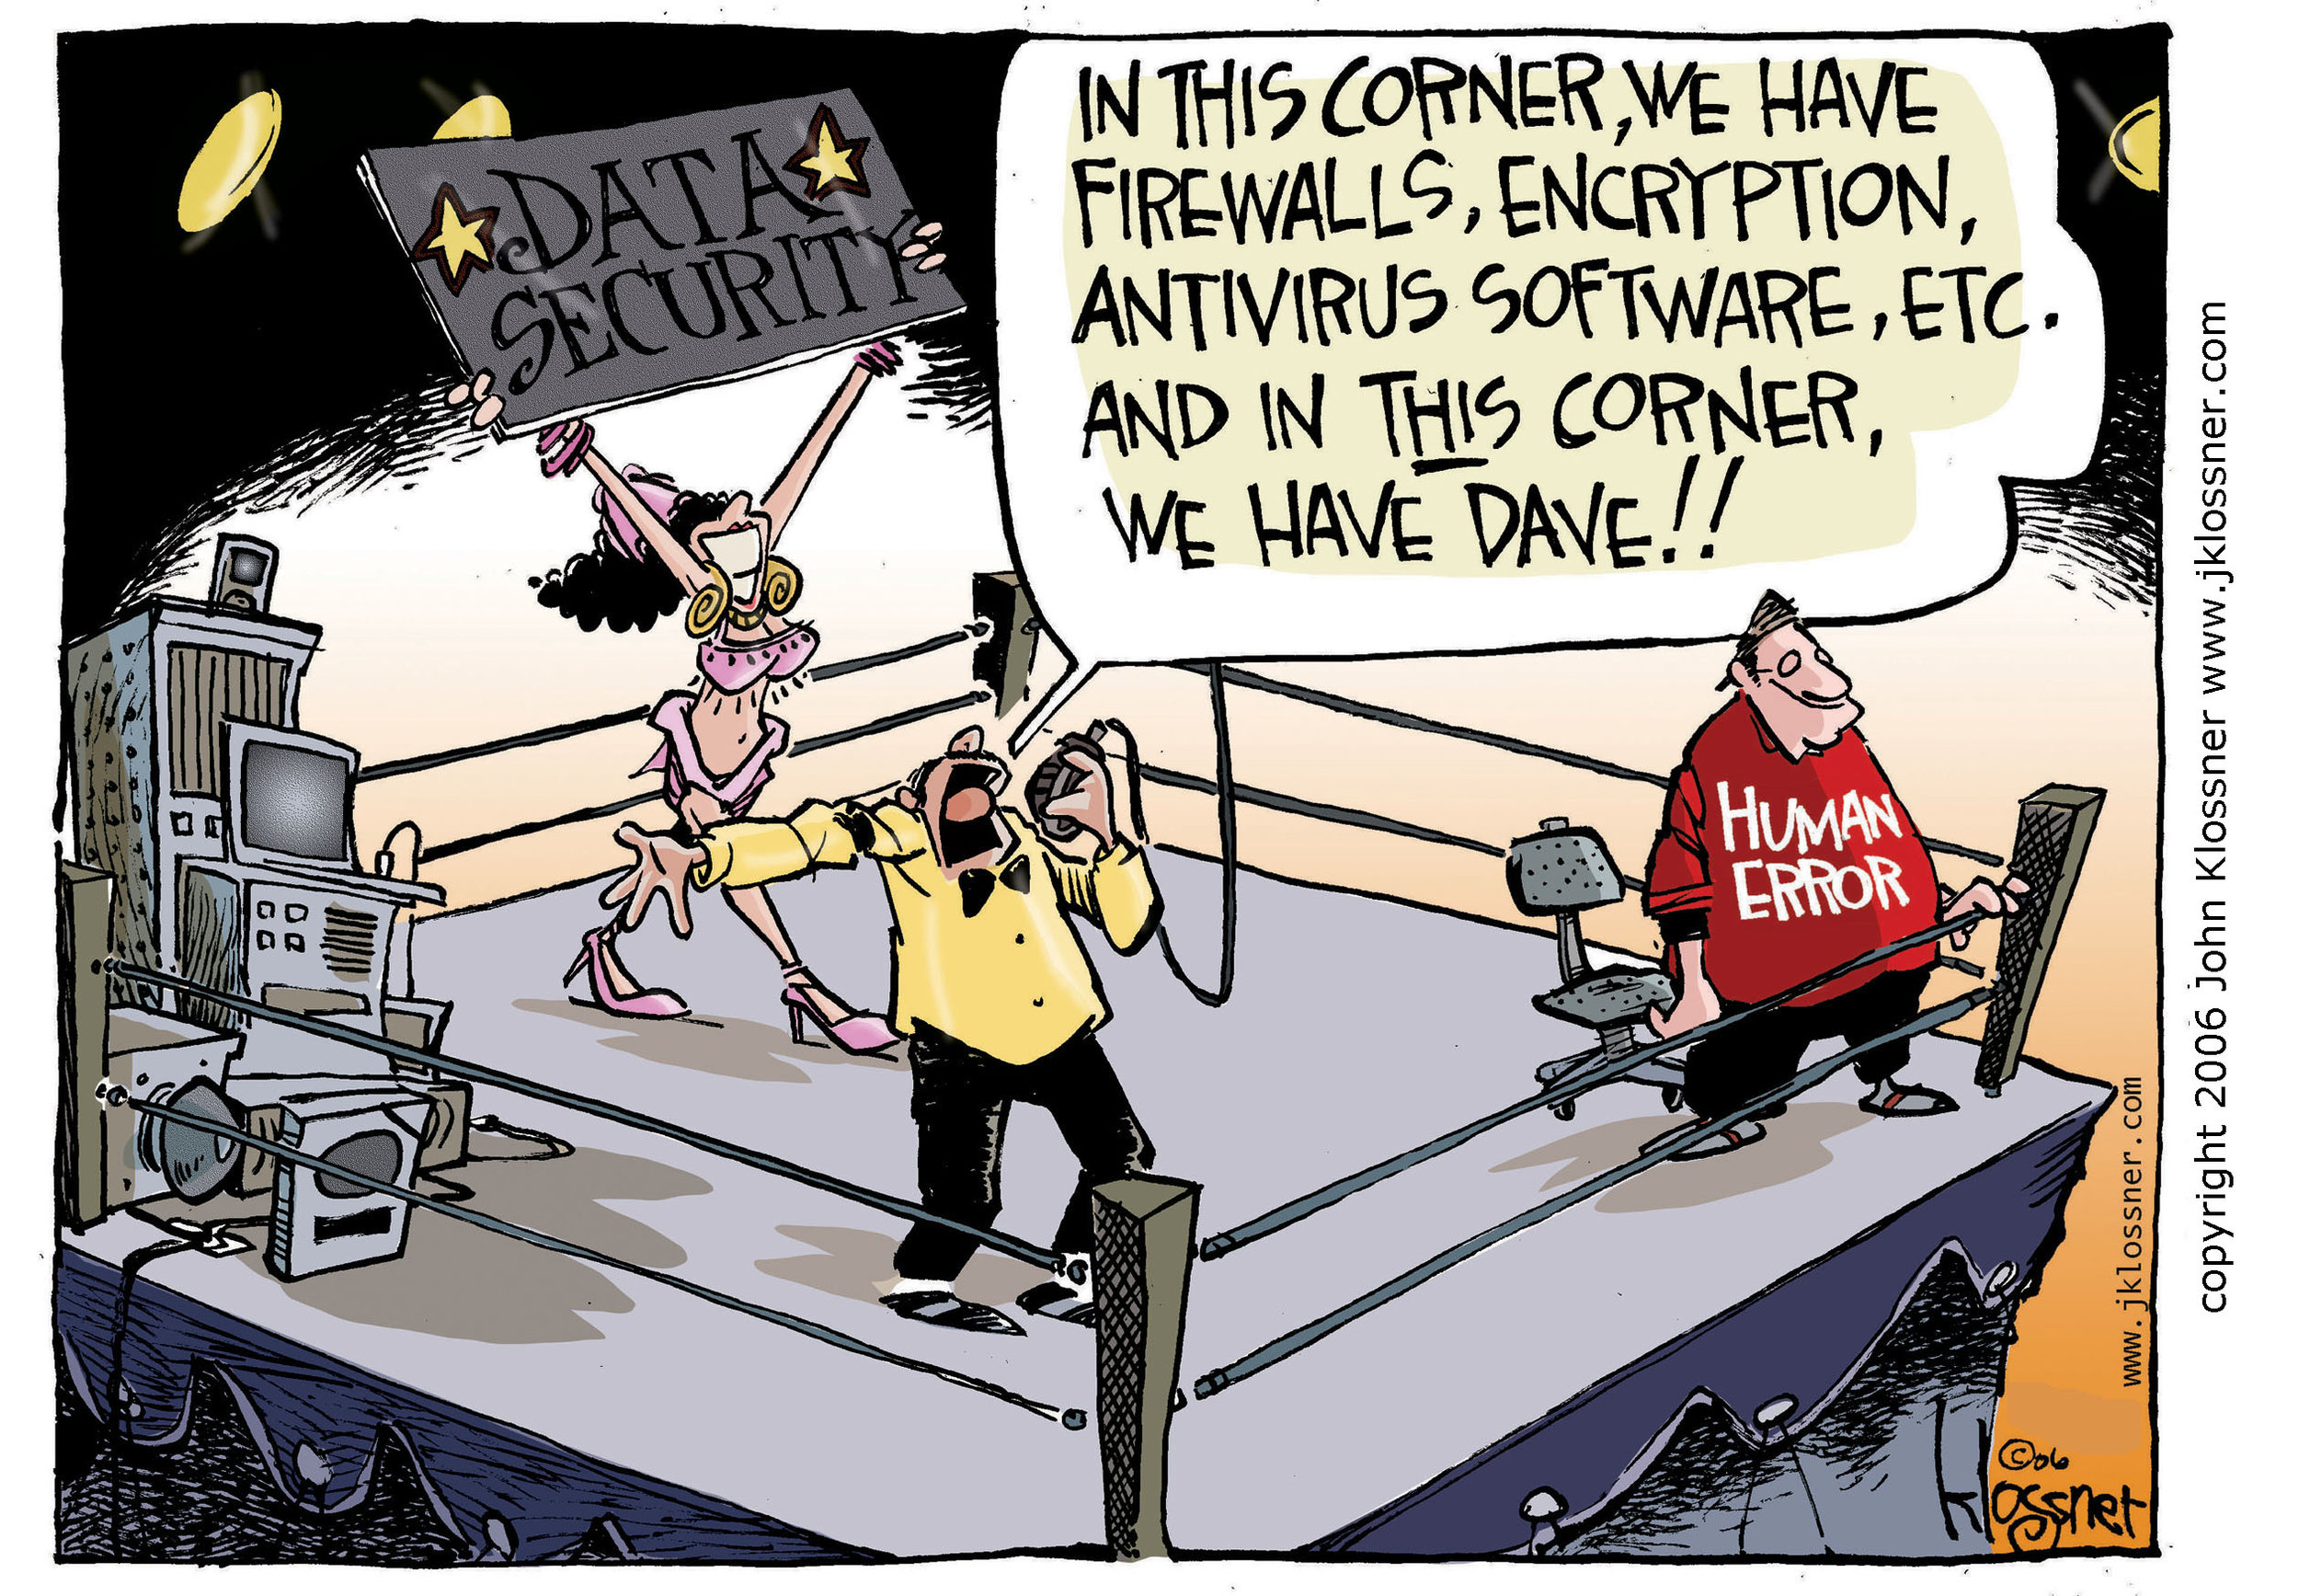

Slide 16
Two-Factor Authentication
This is one of the best steps you can take for protection against a data breach. Passwords alone are not good enough. Two-factor authentication adds another layer of protection for security on password-protected accounts. It works by requiring additional information. For example, a time sensitive code or a push notification to a mobile device are common second factors.
Even if an attacker steals your user credentials through phishing or other means, the attacker cannot access the protected account because the attacker does not have the second factor.

Slide 17
Other Security Tools
Antivirus Software
Firewall Tools
Encryption tools
Network Intrusion Detection
Web Vulnerability Scanning Tools

Slide 18
Training
Do you have training available to your staff:
Easy to understand from an end user perspective
Addresses the basic training modules for identifying and preventing common mistakes, phishing, email compromise, etc.
Addresses Cyber Security policy for equipment usage
Is it required and is it tracked for compliance?

Slide 19
What to do
in the event of an incident
Even a suspected one!

Slide 20
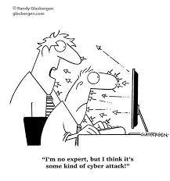

Slide 21
The first few minutes and hours after learning of a cyber incident are crucial to a successful recovery.
Our response to a data breach can determine the extent of the overall loss.
It is important to remember that your local IT resource is not going to be able to fix when a breach occurs

Slide 22
Steps to take
Do not turn off or reboot any systems, but unplug network cables IMMEDIATELY, and/or disconnect the system(s) from the wireless network. Take notes (date; time; who discovered; what tripped the alarm).
Report the incident to: (A) designated person per location policy as well as Catholic Mutual Group and Tokio Marine.
Instruct reporting personnel not to do anything until an appropriate representative is obtained (specifically the Tokyo Marine insurance claims personnel).

Slide 23
Steps to Take, cont.
After confirmation, secure the scene. Do not allow anyone to take any action on affected systems.
Determine if security of sensitive data was breached and, if so, what data elements are included (e.g., name, age, DOB, SNN, medical information).
Preserve and protect the evidence.

Slide 24
Resources Available through CMG Connect and our Partner Tokio Marine

Slide 25
Cyber Security Awareness Video
Training
Phishing
Ransomware
Business Email Compromise
Employee Mistakes
Intro to Data Breaches
Wire Transfer Fraud

Slide 26
CMG’s Cyber Security Handbook
The new CMG Cyber Security Handbook offers guidance on basic security measures and assessment:
Quick Health Check List of Training Resources Wi-Fi security
Antivirus Passwords Phishing
Device Security Back Up Incident Triage
Applicable CARES Materials

Slide 27
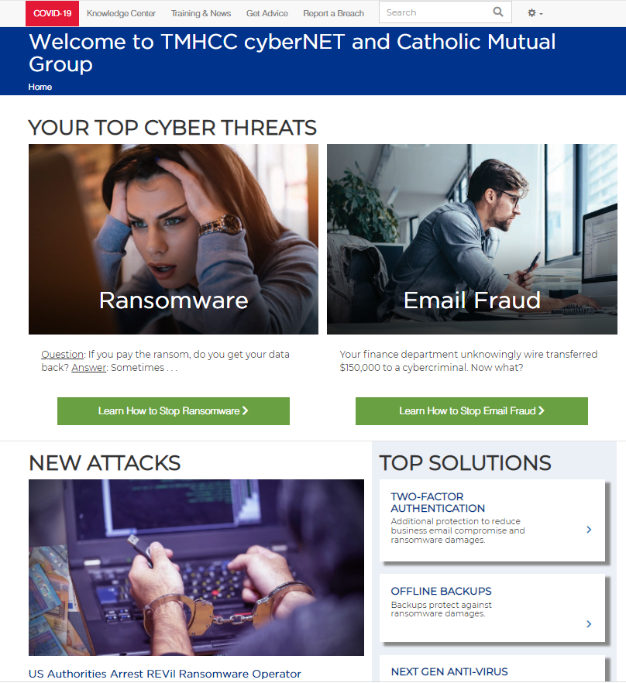
Tokio Marine Risk Management Services and Online Resources
24/7 access to CyberNET risk management website provides your Insureds with vital information, training, and support to prepare for, defend against, and respond to a cyber incident.
Best Practices Guidelines
Risk Assessments and Fitness Checklists
Incident Response Planning
Online Training Courses
Sample Policies / Procedures

Slide 29

Q&A

